Slide 1

Blue Growth in the Mediterranean
Perspectives of Spain
Palma de Mallorca, 2-3 May 2013
Transboundary Planning in the European Atlantic
Margarida Almodovar, DGPM, PT

Slide 2

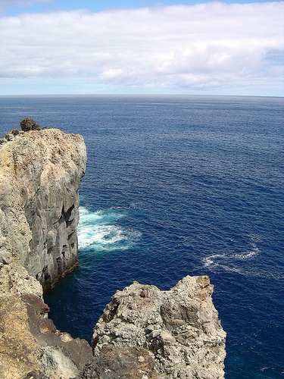
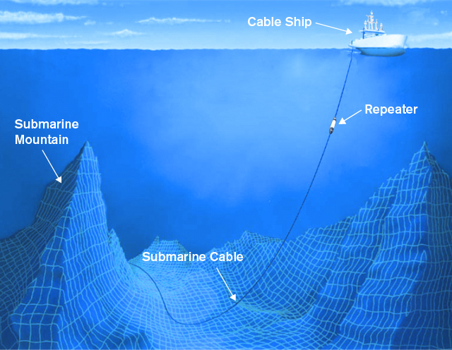
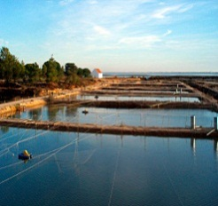
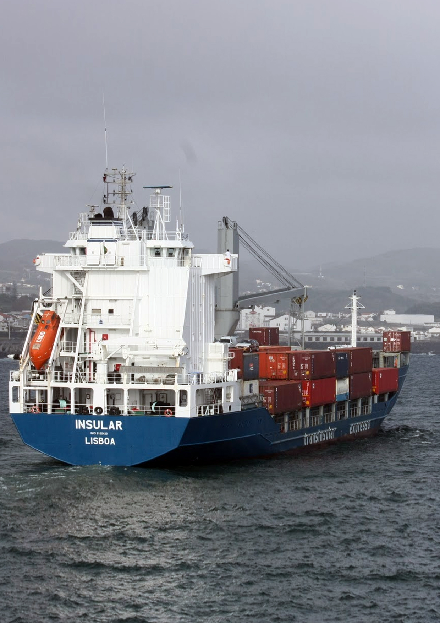
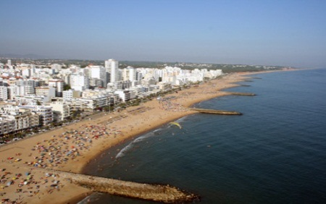
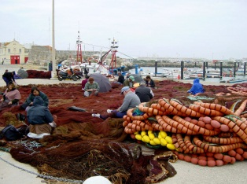
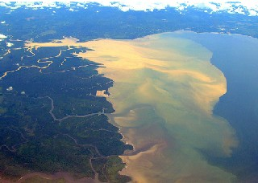
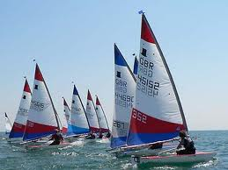
A NEW PROJECT IN THE ATLANTIC REGION
Response to European Commission call for a Project on Maritime Spatial Planning in the Atlantic
Aims to deliver a commonly-agreed approach to cross-border MSP in the European Atlantic region
To be trialled in two contexts: northern (Ireland-UK) and southern (Portugal-Spain)
To investigate the relationship between MSP and Integrated Coastal Zone Management (ICZM) and recommend means for their closer integration.

Slide 3
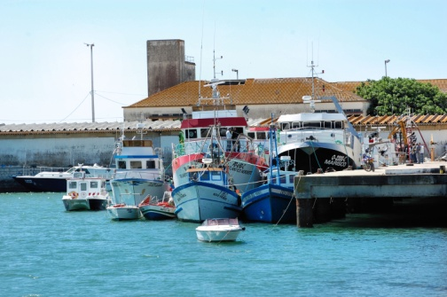
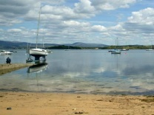
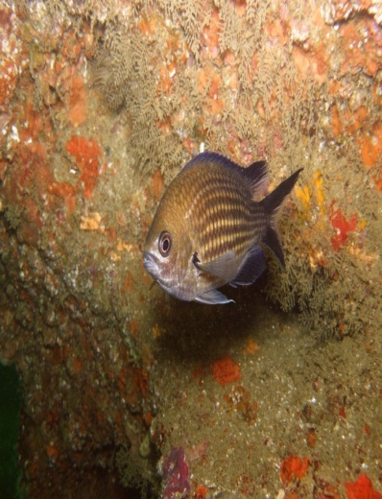
EUROPEAN UNION POLICY
Integrated Maritime Policy
  Economic potential of European seas
  “Maritime spatial planning: a fundamental tool for the sustainable development of marine areas and coastal regions, and for the restoration of Europe’s seas to environmental health”
Roadmap for Maritime Spatial Planning
  10 principles
Matter of national competency
  European Union encourages take-up by Member States and cooperation between them
3

Slide 4
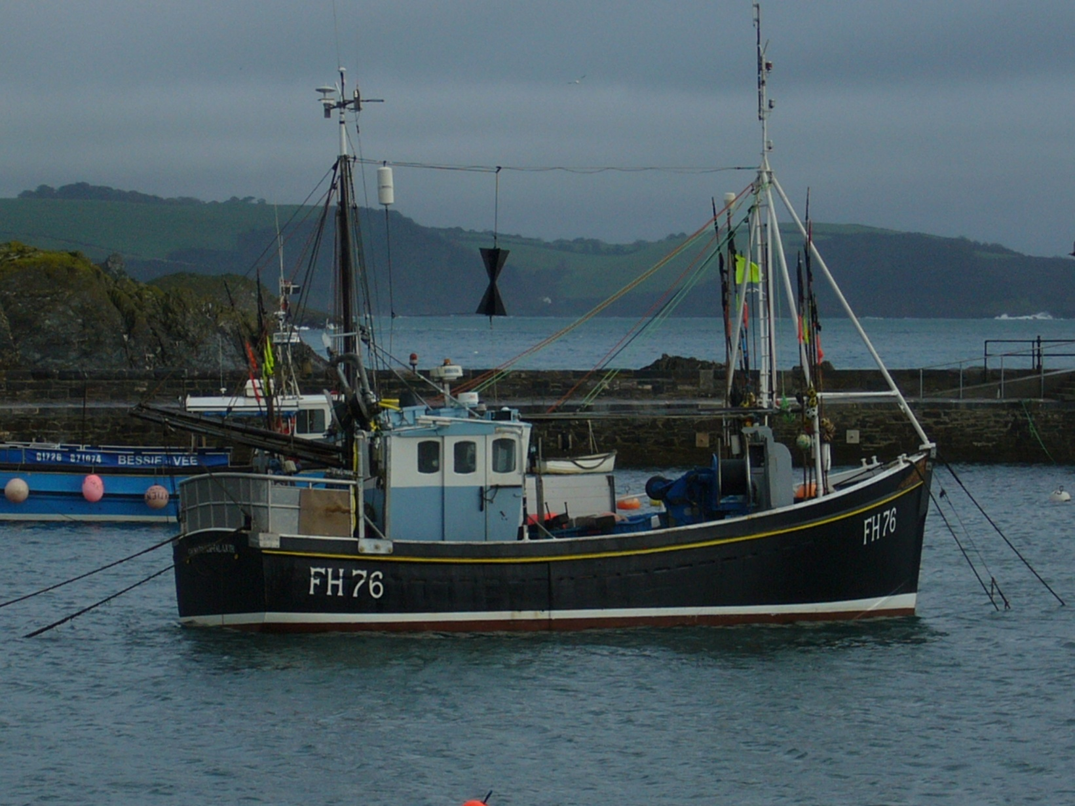
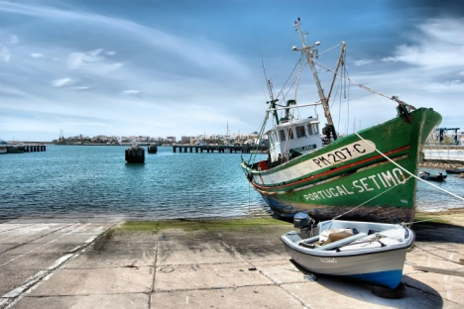
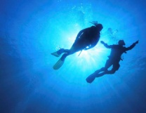
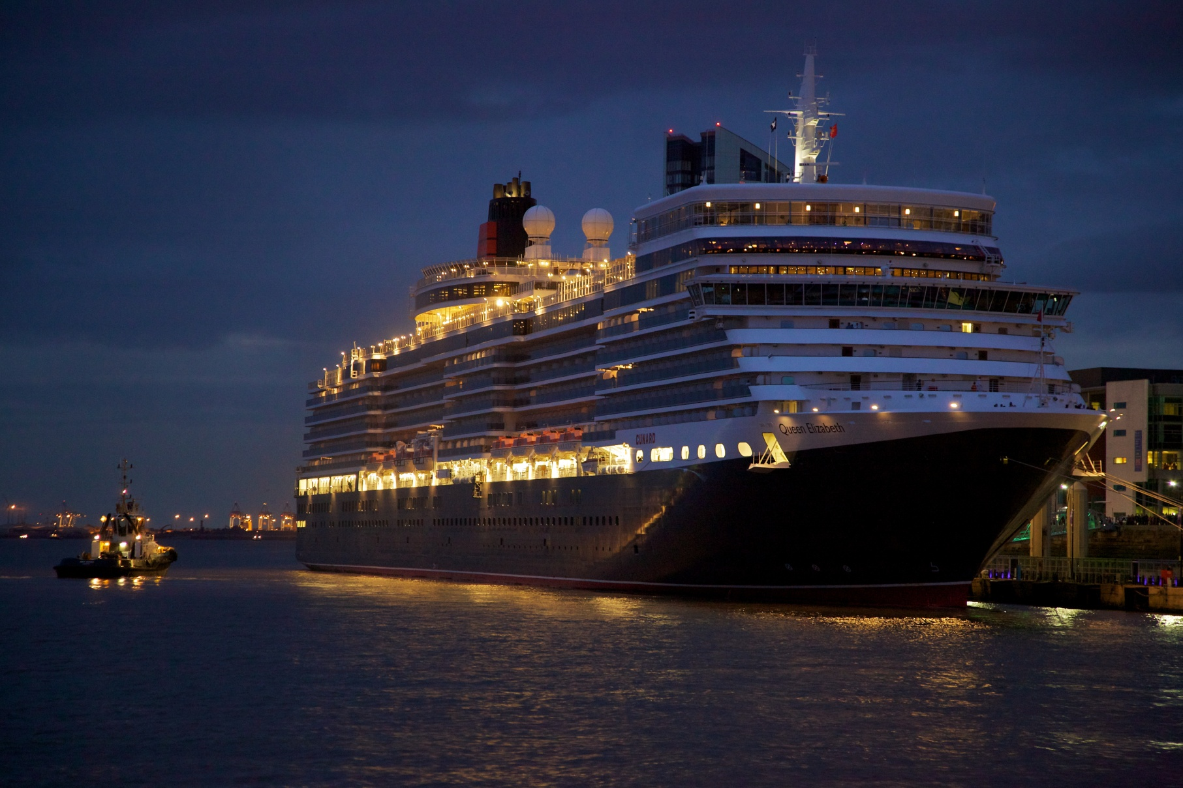
REGIONAL FRAMEWORK, LOCAL FLEXIBILITY
Regional approach
  10 partners
      from Ireland, Portugal, Spain and UK
  Expert advisors
      from all partner nations and France
      regional organisations
        OSPAR, CPMR Atlantic Arc Commission, South Western Waters RAC
Two distinctive contexts
  North: Ireland and UK
  South: Portugal and Spain
  Variations
    implementation of MSP
    coastal and maritime pressures
    policy priorities
    traditions of planning

Slide 5
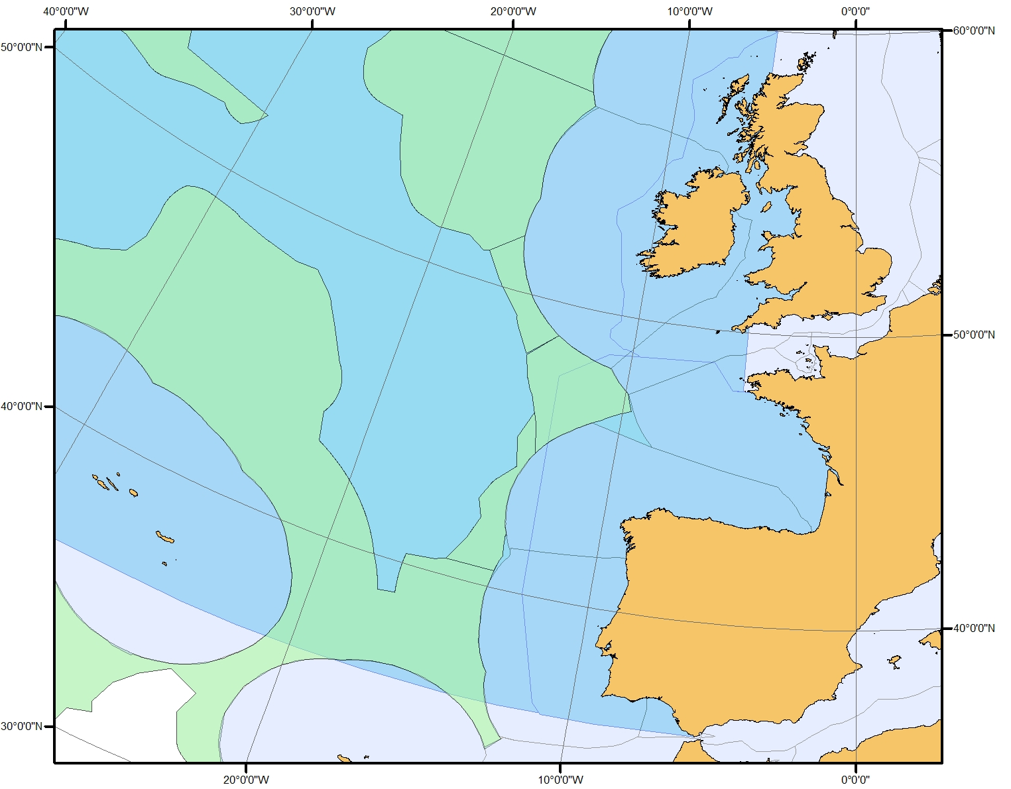
SELECTED PILOT AREAS
Geographical contexts
Pilot areas
Northern context (IR – UK)
East Coast – Irish Sea
Southern context (PT – ES)
Algarve – Bay of Cádiz
5

Slide 6
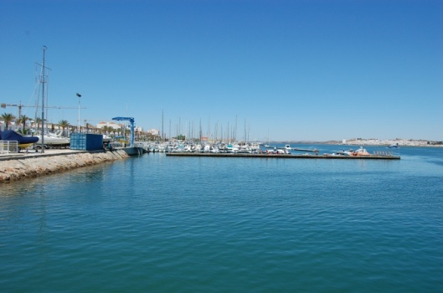
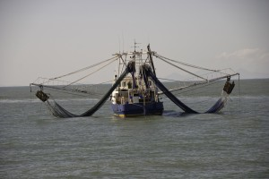
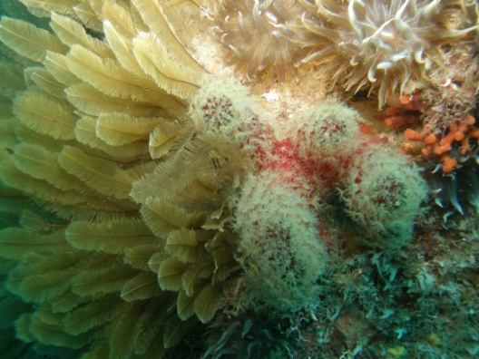
GAINING LEGITIMACY
Sensitivity to national MSP competences
Project brief: “greatest possible involvement of relevant authorities”
Bilateral stakeholder engagement

Slide 7
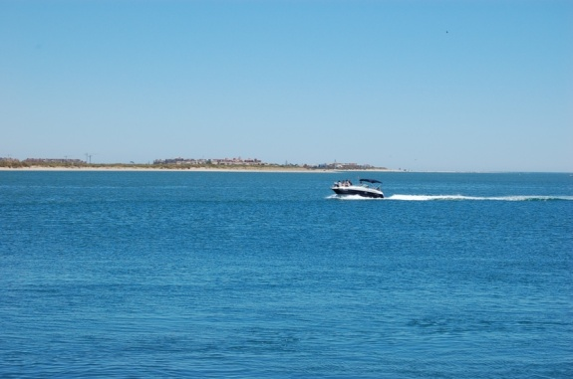
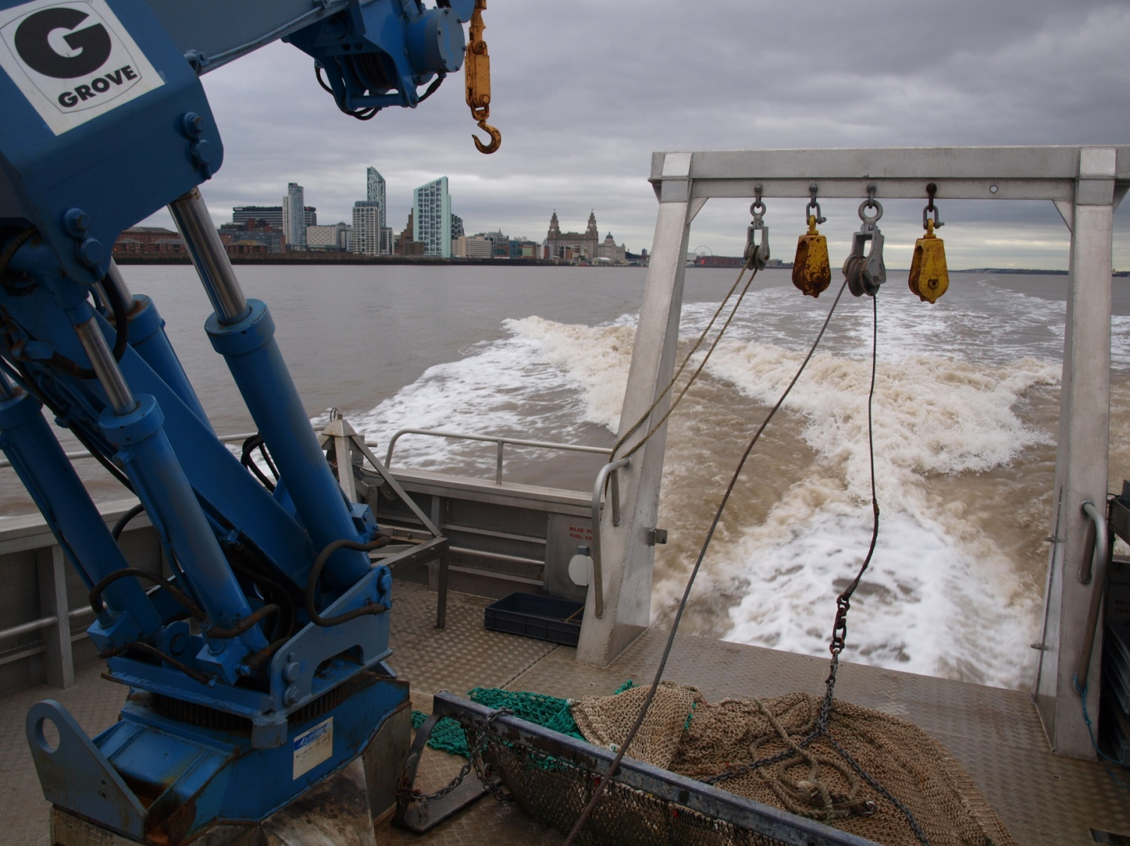
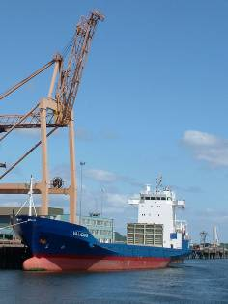
MSP PROCESS
Conceptual framework
  legal, technical and stakeholder aspects
Initial assessment and selection of pilot areas
Developing MSP outcomes
  Setting objectives
  Data-gathering
  Analysing context
  Geographical representation
  Developing options
  Stakeholder engagement
  Evaluation
Communication

Slide 8
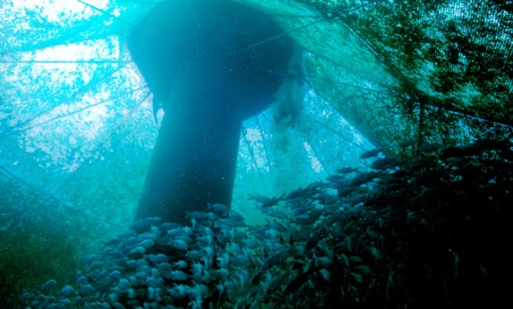
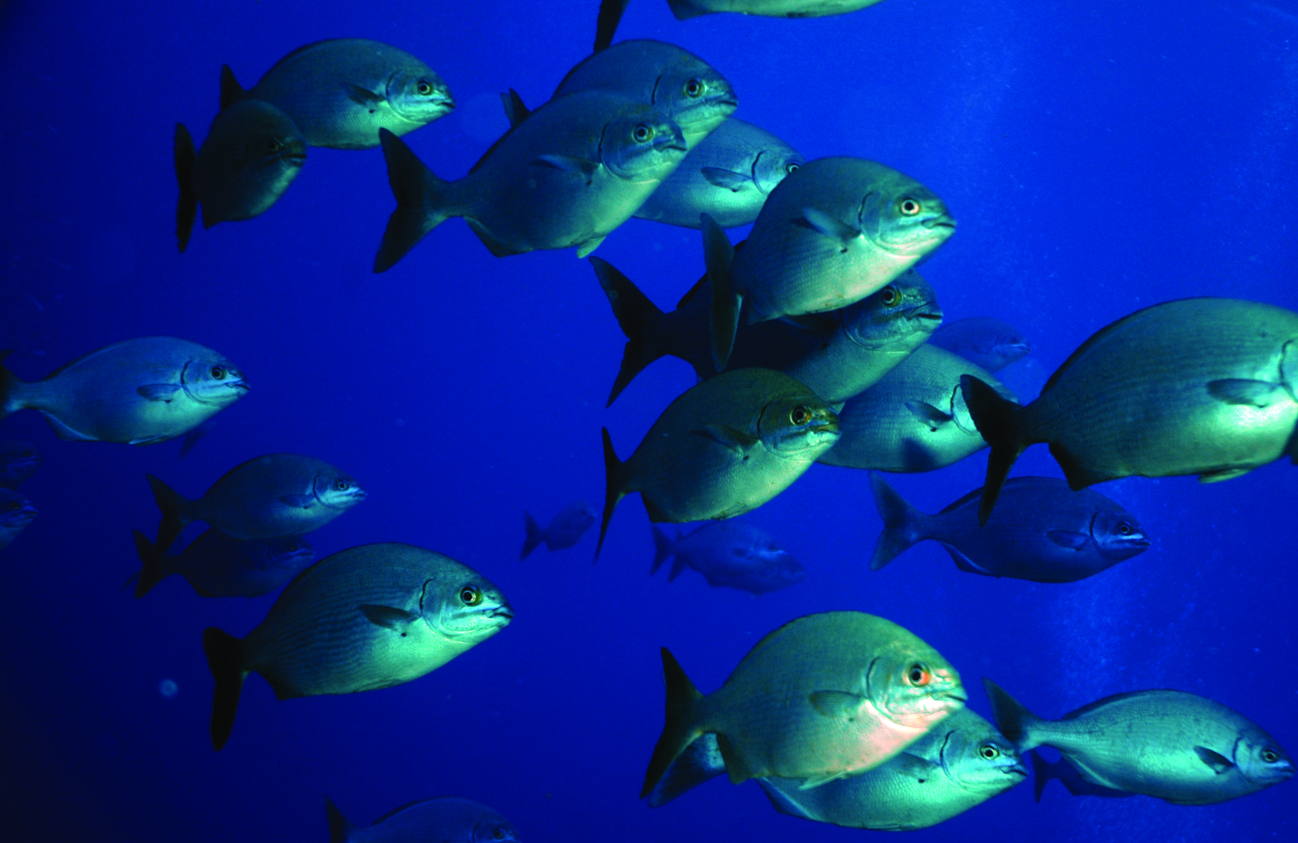
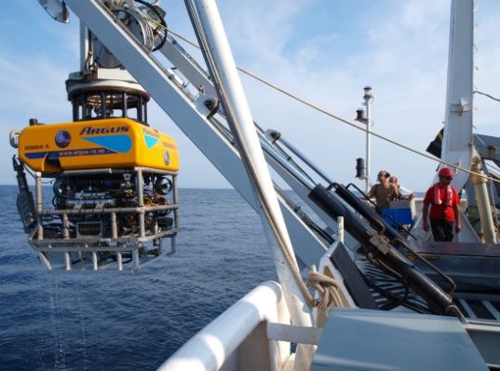
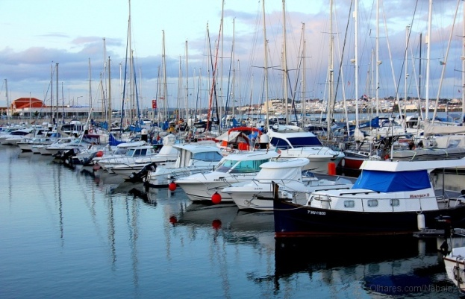
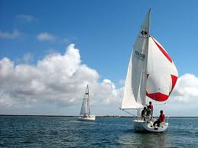
MARITIME SPATIAL PLANNING
Potential key transboundary issues
  Blue Grow
  Exploitation of living and non-living natural marine resources
  Recreational activities

Slide 9

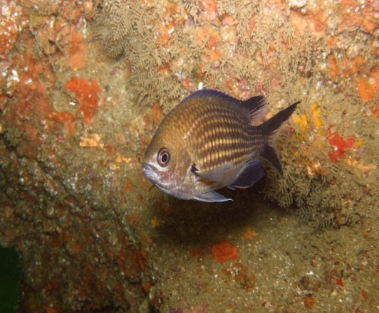
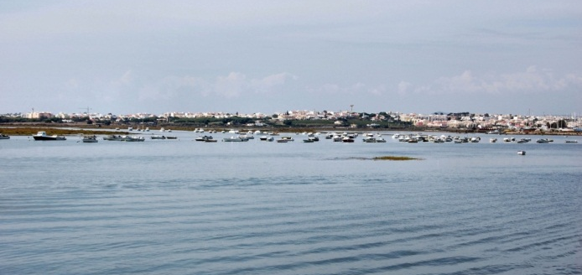
MARITIME SPATIAL PLANNING
Potential key transboundary issues (south area Guadiana – Cadiz Bay)
  Natural Values and biodiversity
  Aquaculture
  Non living Natural Resources
  Fisheries and port activity
  Tourism and recreational activities

Slide 10
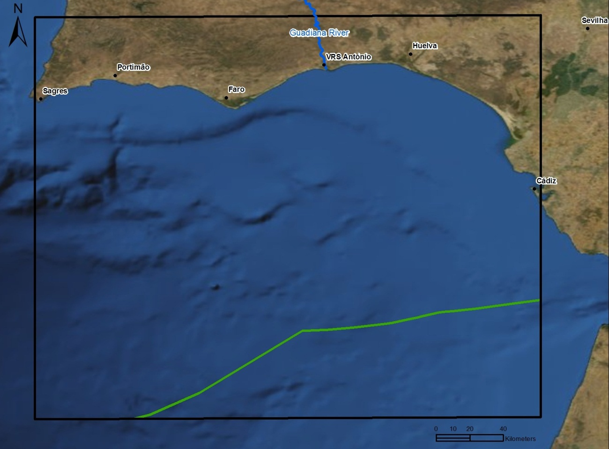
SELECTED PILOT AREAS
Developing MSP outcomes - South context
COASTAL ZONE
?
MARITIME SPACE
?
10

Slide 11
PLANNING
Kick-off meeting
Steering group meeting
3-4 December
Lisbon
First Stakeholders Workshop
12 March
Vila Real de Sto. António
Work Package |  | Project month
 |  | 2012 | 2013 |  |  |  |  |  |  |  |  |  |  |  | 2014
 |  | Dec | Jan | Feb | Mar | Apr | May | Jun | Jul | Aug | Sep | Oct | Nov | Dec | Jan | Feb | Mar | Apr | May
 |  | 1 | 2 | 3 | 4 | 5 | 6 | 7 | 8 | 9 | 10 | 11 | 12 | 13 | 14 | 15 | 16 | 17 | 18
1.1 | Conceptual framework |  |  | CFR
1.2 | Initial assessment |  |  |  | SW IAR
1.3 | Cross-border MSP |  |  |  |  |  |  | SW |  |  |  |  |  |  | SW |  | PD
1.4 | Evaluation
2 | Reporting |  |  |  |  |  | IR |  |  |  |  |  | IR |  |  |  |  |  | FR
3 | Management |  |  |  | SG |  |  |  |  |  |  | SG |  |  |  |  | SG
4 | Communication
Launch event
4 March
Cork
Final conference
SW - Stakeholders workshop
SG - Steering group meeting
CFR - Conceptual framework report
FR - Final report
IAR - Initial assessment report
IR - Interim report
PD - Planning documents

Slide 12

CONTACT US
National contacts
  ES Ms Lola Ortiz Sánchez dortiz@magrama.es
  IR Mr Cathal O'Mahony c.omahony@ucc.ie
  PT Ms Margarida Almodovar margarida.almodovar@dgpm.gov.pt
  UK Mr Gerard McClarey Gerard.McClarey@doeni.gov.uk
Project coordinator
  Dr Stephen Jay stephen.jay@liv.ac.uk
  Visit www.tpeamaritime.eu
  Thank you for your attention!

Slide 13
Blue Growth in the Mediterranean
Perspectives of Spain
Palma de Mallorca, 2-3 May 2013
THANK YOU!

